Slide 1
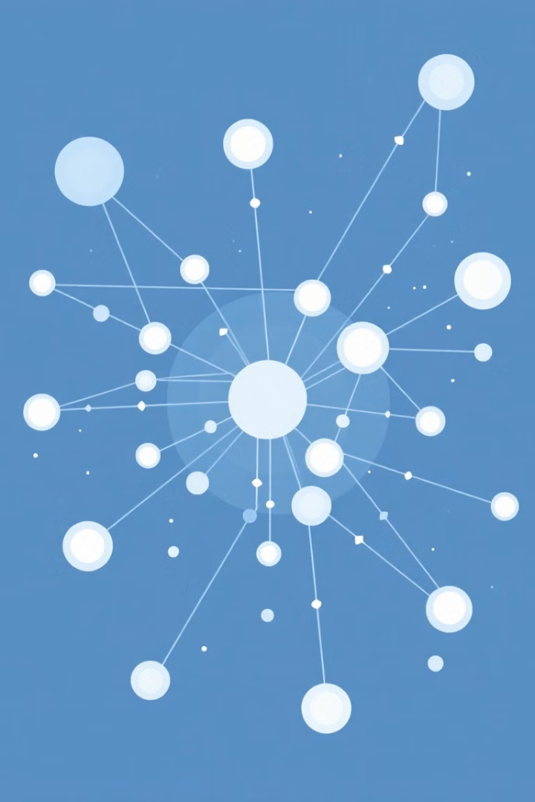

Advanced Algorithms for Directed Acyclic Graphs (DAGs)
This presentation will dive into the world of DAGs, covering their fundamental characteristics, representation, traversal algorithms, and applications.
by Kunja Srinivas
by Dikshith
Guided by
Dr.G.Michael

Slide 2
Introduction to Directed Acyclic Graphs (DAGs)
Definition
Importance
A directed acyclic graph is a directed graph with no cycles, meaning there's no path from a node to itself.
It can be used to represent processes where some tasks must be performed before others (e.g., dependency graphs).
A D A G is often used in:
Scheduling problems (e.g., tasks with dependencies).
Workflow systems.
Representing expressions in compiler design.
Graph-based algorithms like topological sorting.
DAGs are widely used in diverse fields including computer science, biology, and social networks.
Dependency Management: DAGs help represent tasks or processes with dependencies, ensuring proper execution order (e.g., task scheduling, project planning).
Topological Sorting: They allow arranging nodes in a sequence where dependent tasks are executed after their prerequisites.
Data Processing: Used in data pipelines (e.g., Apache Spark, TensorFlow) to optimize workflows and computations.

Slide 3
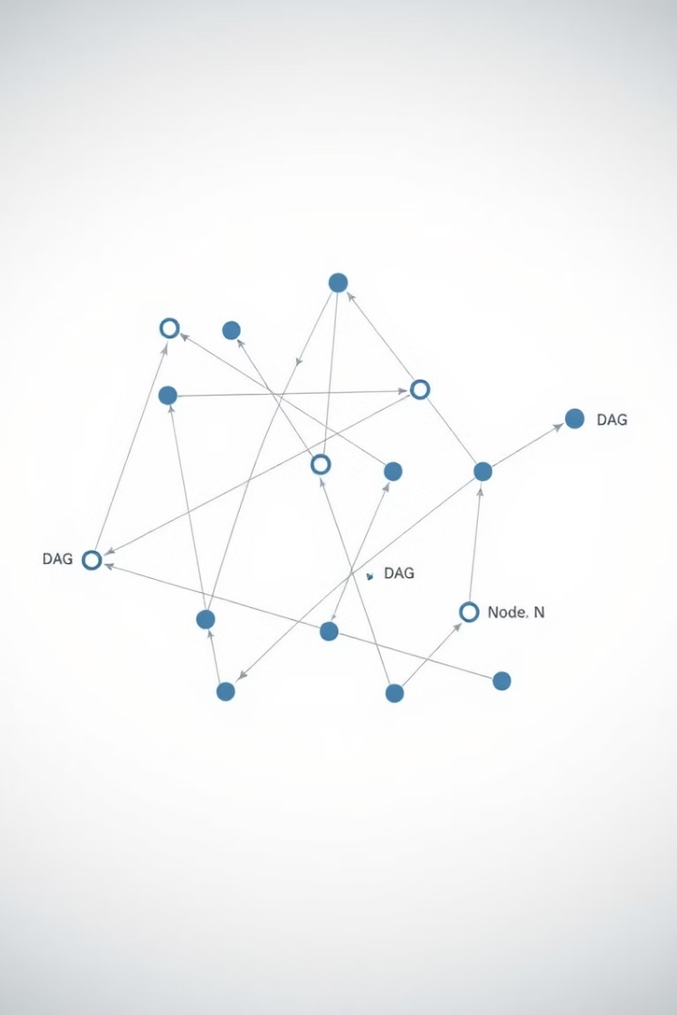
Fundamental Characteristics and Applications of DAGs
No Cycles
Unique Paths
The absence of cycles is a defining feature of DAGs.
There's only one path between any two nodes in a DAG.
Diverse Applications
DAGs are used in tasks like scheduling, data dependency tracking, and computational optimization.

Slide 4
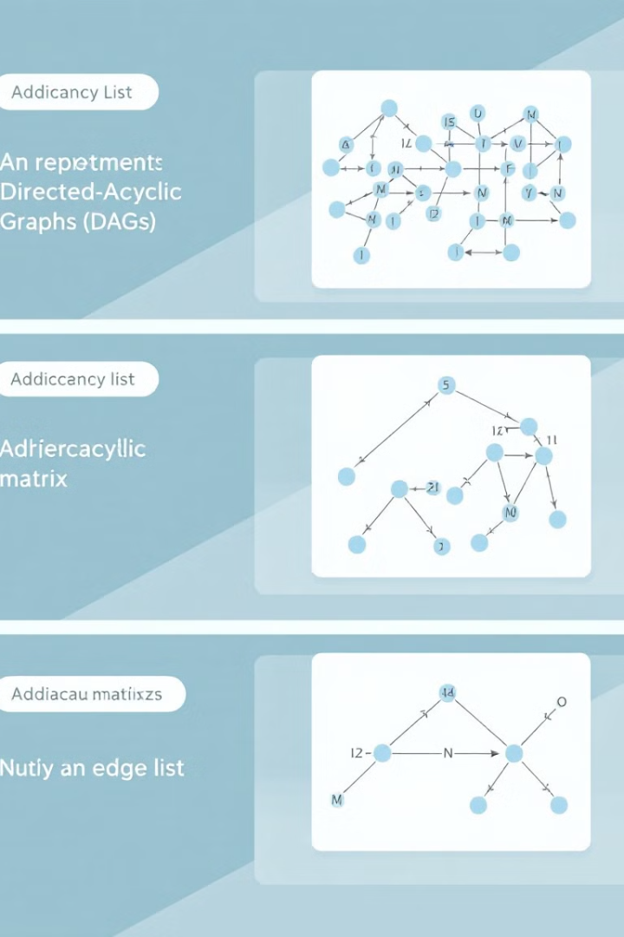
Representation and Data Structures for DAGs
Adjacency List
Adjacency Matrix
A list of nodes with each node connected to its neighbors . An a way to represent a graph using lists or arrays.
A matrix where rows and columns represent nodes, and entries represent connections.
Edge List
A list of all edges in the graph, each edge represented as a pair of nodes.
represents a graph by storing each node and its connected neighbors, making it efficient for sparse graphs

Slide 5
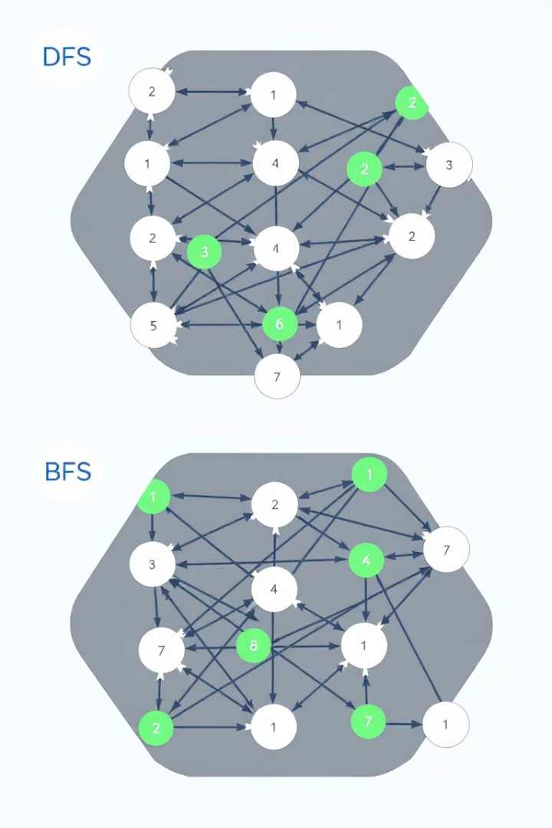


Traversal Algorithms: Depth-First Search (DFS) and Breadth-First Search (BFS)
Depth-First Search
Breadth-First Search
Explores as far as possible along each branch before backtracking.
graph traversal algorithm that explores as far as possible along each branch before backtracking. It uses a stack (either explicitly or via recursion) to track the nodes.
Explores all nodes at a given level before moving to the next level.
graph traversal algorithm that explores all neighbors of a node before moving to their neighbors. It uses a queue to ensure nodes are processed level by level.

Slide 6

Topological Sorting and its Significance
Definition
A linear ordering of nodes where for every directed edge from node 'u' to node 'v', 'u' appears before 'v' in the ordering.
1
2
Applications
Used for scheduling tasks with dependencies, resolving dependencies in software, and analyzing data flow in pipelines.

Slide 7
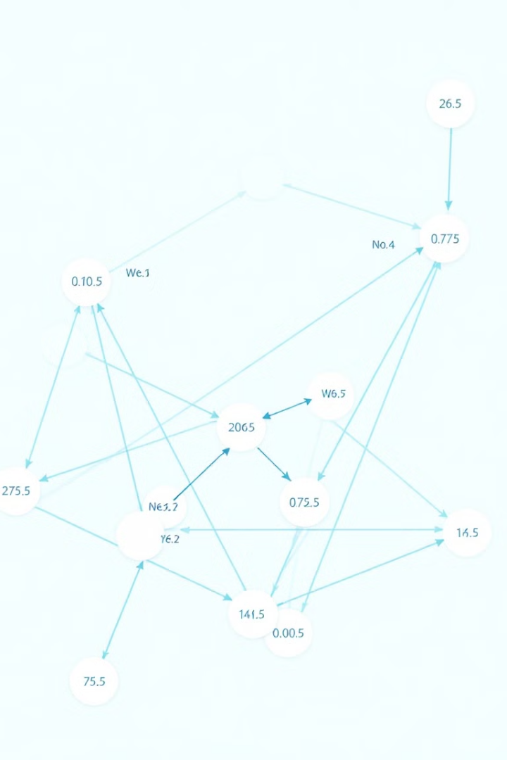
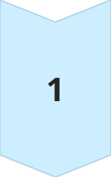
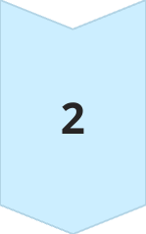
Shortest Path Algorithms for DAGs: Dijkstra's and Bellman-Ford
Dijkstra's Algorithm
Efficient for finding shortest paths when edge weights are non-negative.
Bellman-Ford Algorithm
Can handle negative edge weights, but is less efficient than Dijkstra's for non-negative weights.

Slide 8
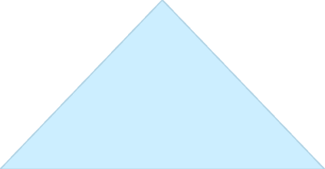

Transitive Closure and Reachability Queries
Transitive Closure
1
A matrix that represents the reachability relationships between all pairs of nodes in a DAG.
Reachability Queries
2
Used to efficiently determine if a node is reachable from another node in a DAG.

Slide 9
Optimizing DAG Operations: Parallelization and Distributed Processing
Parallelization
1
Dividing a DAG into smaller tasks that can be processed simultaneously across multiple processors.
Distributed Processing
2
Distributing the DAG across multiple machines for improved scalability and fault tolerance.

Slide 10
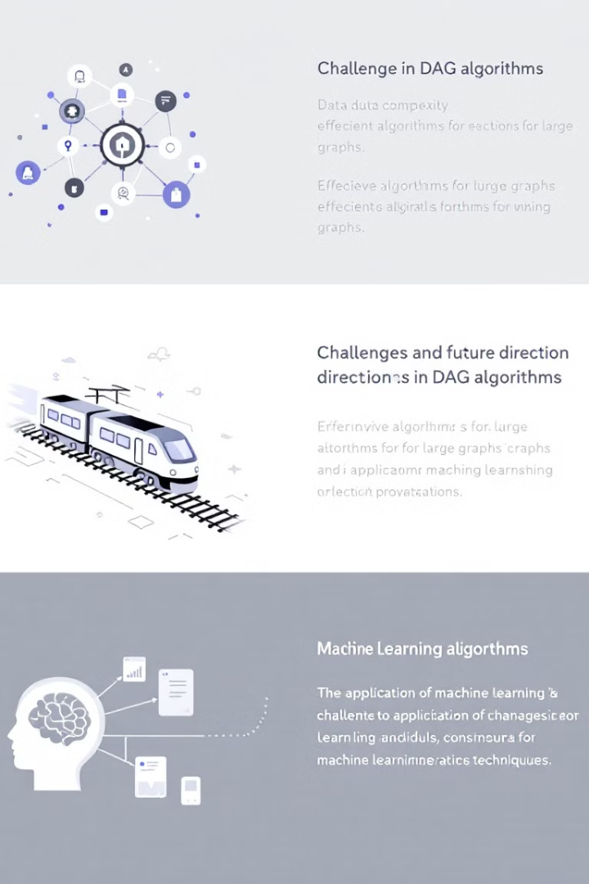
Challenges and Future Directions in DAG Algorithms
1
2
Data Complexity
Machine Learning
Handling large and complex DAGs requires efficient algorithms and data structures.
Exploring the application of machine learning techniques to optimize DAG analysis and processing.

Slide 11
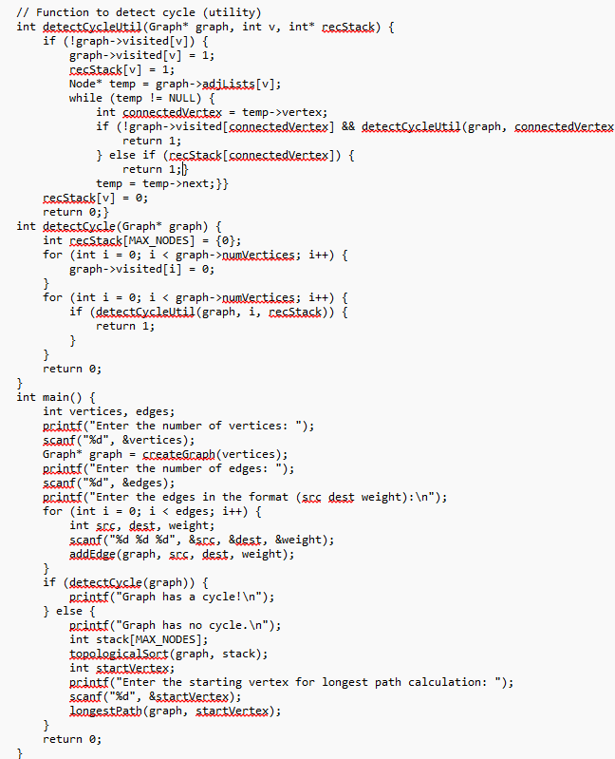
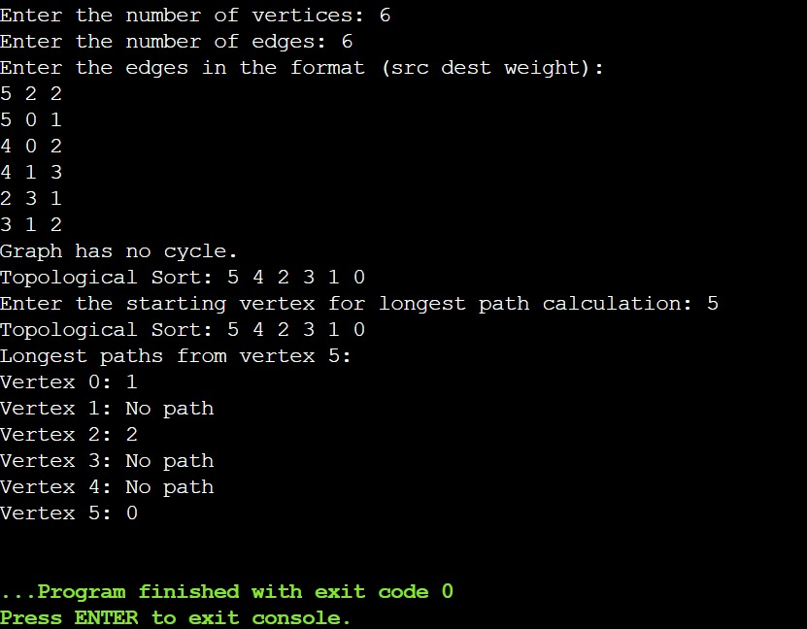
OUTPUT

Slide 12

Conclusion
Directed Acyclic Graphs (DAGs) offer a powerful framework for representing and processing complex relationships.Their applications span various domains, including scheduling, data analysis, and machine learning.
The integration of dynamic updates and application-specific optimizations further enhances the system's adaptability to real-world use cases, such as task scheduling and workflow optimization. Overall, this work provides a robust and scalable framework for efficiently managing and analyzing large and complex DAGs in both academic research and practical applications.

Slide 13
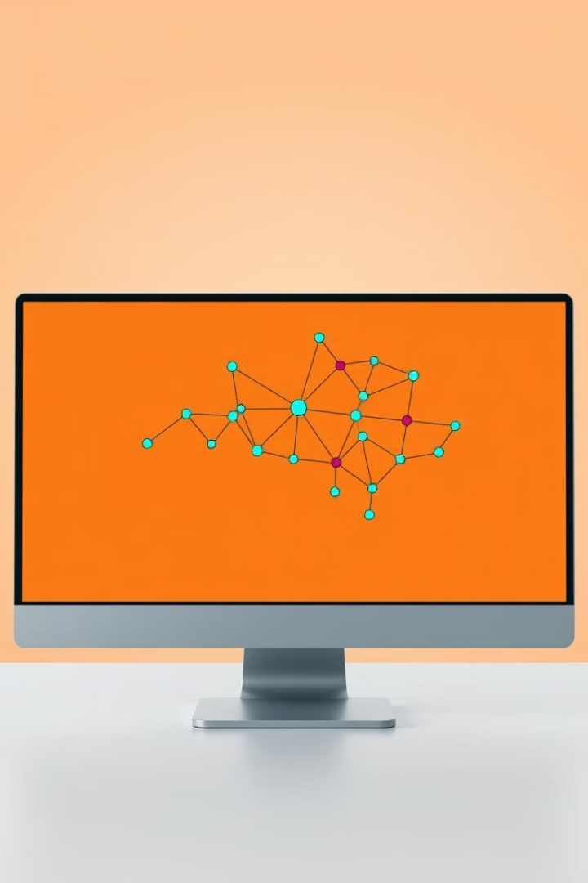
THANK YOU

